Slide 1
EXECUTIVE REPORT | MONTHLY WORKFORCE ROSTER
Executive Summary
38
Agents needed
100.0%
Demand hours covered
10/10
Hard rules met
Rp 199M
Pay this month
KEY FINDING
WHAT DRIVES THE NUMBER
38 agents cover January's demand with 736 shifts, 203 of them with overtime.
Only 1 of 3,379 required agent-hours is short, while every labor-law and company rule holds.
The weekend-off rule: nobody may work both Saturday and Sunday, so each weekend needs two separate crews. Without it, 27 agents would be enough.
The model minimizes penalties (missing demand first); pay is reported, not optimized.
Mixed-Integer Programming (PuLP / CBC) | January 2027
01/07

Slide 2
EXECUTIVE REPORT | MONTHLY WORKFORCE ROSTER
Hard Rules, Re-Checked on the Final Roster
Rule
Worst case
Limit
Met
Max work days in any 7 days
5
5
Yes
Longest run of work days
5
5
Yes
Longest run of days off
2
2
Yes
Max overtime hours in one shift
2
2
Yes
Max overtime hours in any 7 days
5
18
Yes
Overtime on two consecutive days
0
0
Yes
DO-Work-DO patterns
0
0
Yes
Agents working both Sat and Sun
0
0
Yes
Night -> morning rotations
0
0
Yes
Rest under 8h between shifts
0
0
Yes
Mixed-Integer Programming (PuLP / CBC) | January 2027
02/07

Slide 3
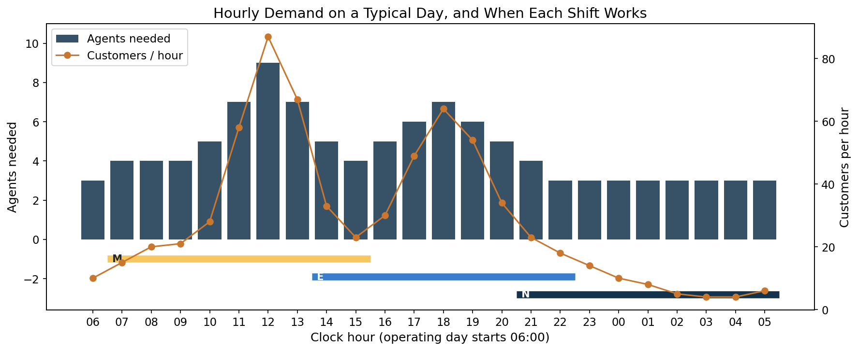
EXECUTIVE REPORT | MONTHLY WORKFORCE ROSTER
Demand and the Three Shifts
AGENTS NEEDED PER HOUR, SAME EVERY DAY
WHAT TO NOTICE
Demand peaks sharply at lunch (12:00) and dinner (18:00).
Fixed 9-hour shifts cannot follow such sharp peaks without idle hours around them.
No base shift covers 06:00-07:00; only overtime can.
Demand is an assumption; a forecast would replace it.
Mixed-Integer Programming (PuLP / CBC) | January 2027
03/07

Slide 4
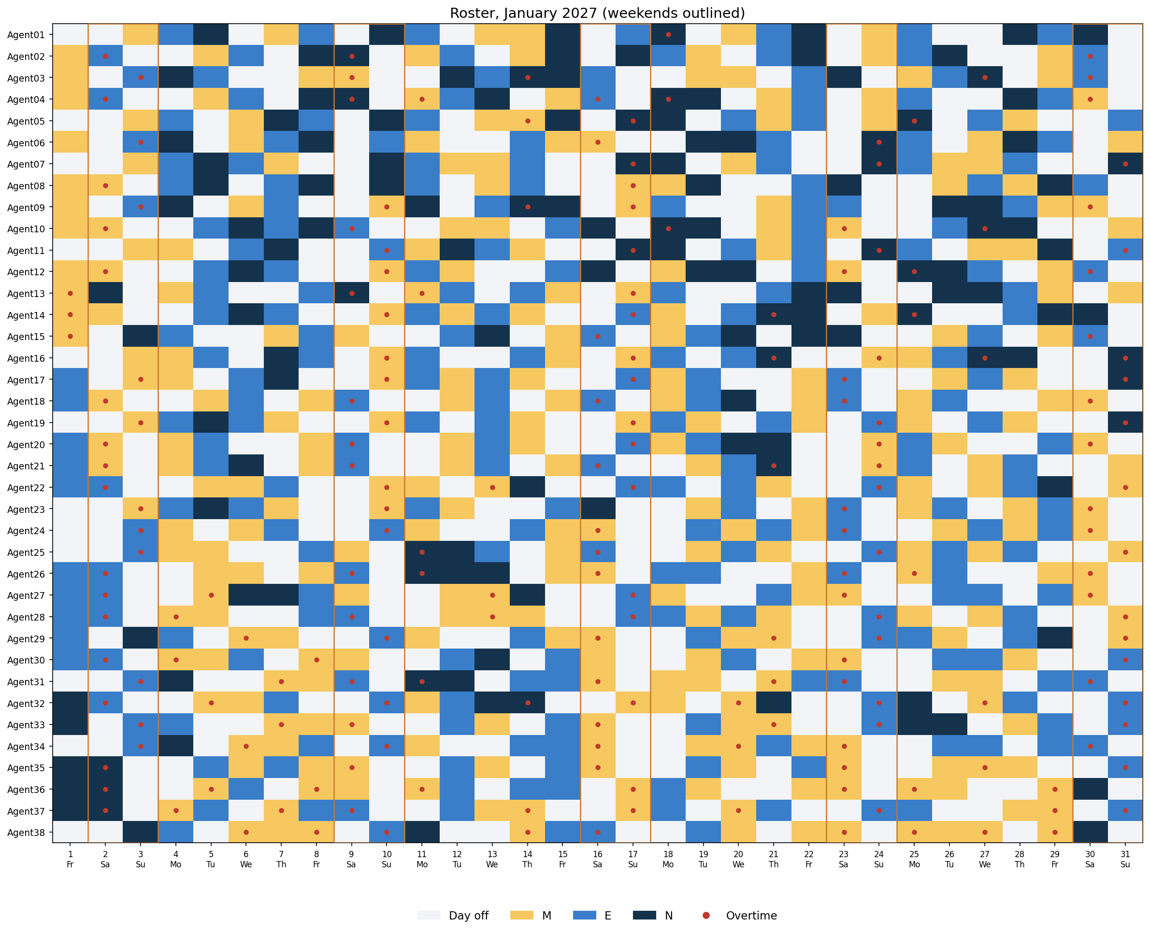
EXECUTIVE REPORT | MONTHLY WORKFORCE ROSTER
The January Roster
ONE ROW PER AGENT, ONE COLUMN PER DAY
Full roster as a pivot table (agent x date, shift codes such as M11 or E18_A2) in result/roster_january_2027.csv.
Mixed-Integer Programming (PuLP / CBC) | January 2027
04/07

Slide 5
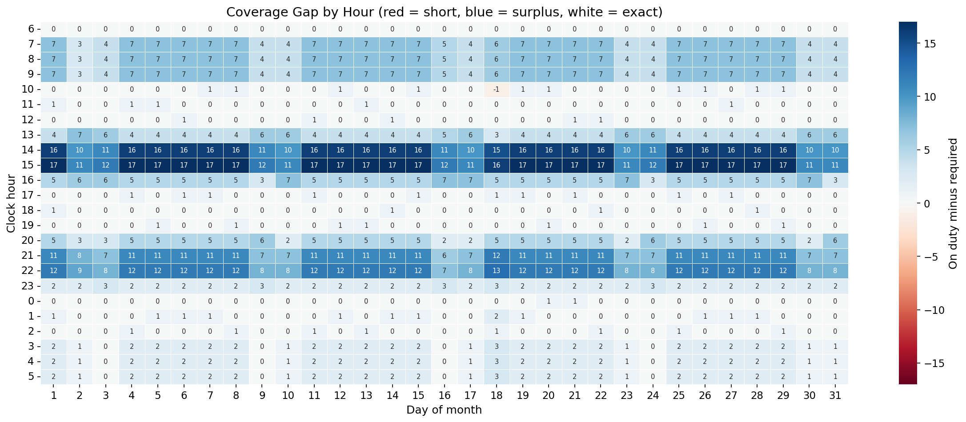
EXECUTIVE REPORT | MONTHLY WORKFORCE ROSTER
Coverage Hour by Hour
ON DUTY MINUS REQUIRED, EVERY HOUR OF THE MONTH
Short: 1 agent-hour(s); surplus: 2,823 agent-hours over the month. Surplus concentrates at 14:00, 15:00, 21:00, 22:00, where shifts overlap.
Mixed-Integer Programming (PuLP / CBC) | January 2027
05/07

Slide 6
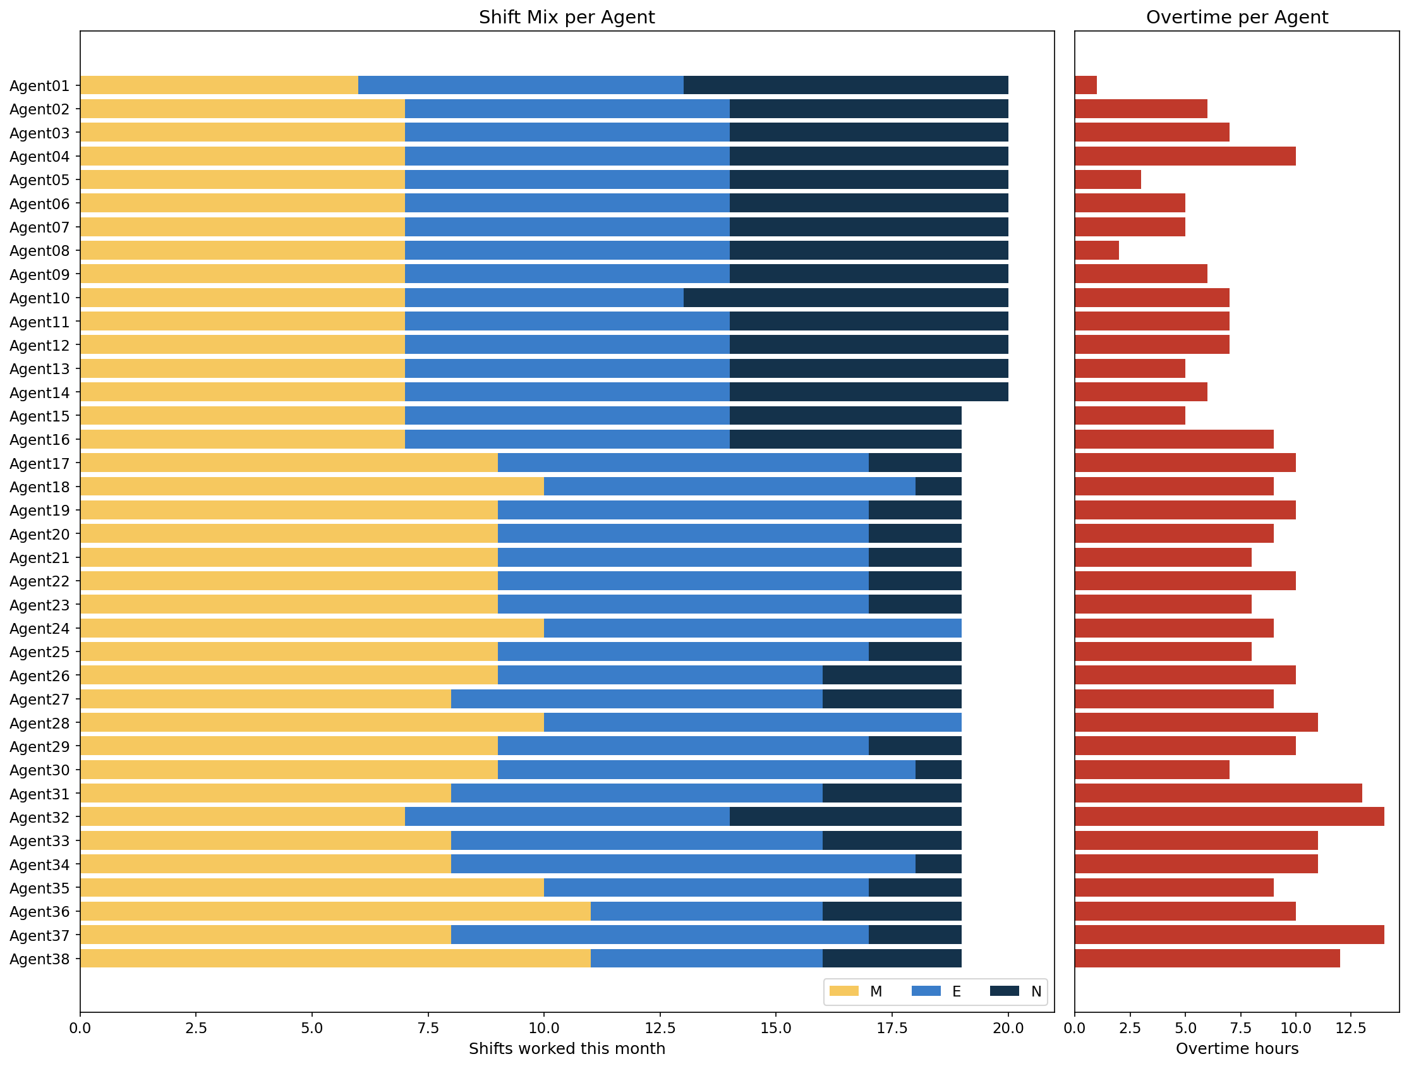
EXECUTIVE REPORT | MONTHLY WORKFORCE ROSTER
Fairness: Shift Mix and Overtime
SHIFTS AND OVERTIME PER AGENT
SPREAD ACROSS AGENTS
19-20
Days worked per agent
1-14 h
Overtime per agent this month
Mixed-Integer Programming (PuLP / CBC) | January 2027
06/07

Slide 7
EXECUTIVE REPORT | MONTHLY WORKFORCE ROSTER
Recommendations and Next Steps
RECOMMENDATIONS
NEXT STEPS
Staff the store with 38 agents on M / E / N shifts.
Review the weekend-off rule: it alone adds 11 agents. A rotating rule (e.g. one full weekend off per month) is worth testing with this model.
Stagger shift start times: idle hours pile up at 14:00, 15:00, 21:00, 22:00.
Replace assumed demand with a forecast of customers per hour.
Derive agents per hour from the queueing simulation (Self-Order Terminal project).
Add leave requests, public holidays and agent preferences as extra penalties.
Mixed-Integer Programming (PuLP / CBC) | January 2027
07/07

